Slide 1

Group 4 – Housing Data
Jessie Lyle
Mastura Mir
Jas Sur
Monica Hogue

Slide 2

Housing Data
Source: We used data from the Zillow website: https://www.zillow.com/research/data/
Home Values Forecasts
Inventory
List and Sale Prices
Goal: to show trends in the Housing in market within the US, Texas and Houston
Key Takeaways:
Not all states are increasing in median price
There is an overall increase in sales even in areas where home values are increasing
Central/Downtown Houston has one of the lowest forecasted percent increase in Houston Metropolitan Area
Notes:
We wanted to look for trends in the housing market.
The data uses median prices and not mean because the median represents the typical value.
We compared
-median prices of each state
-changes over time
-prices of major cities in Texas
-forecasted percent increase for Houston

Slide 3
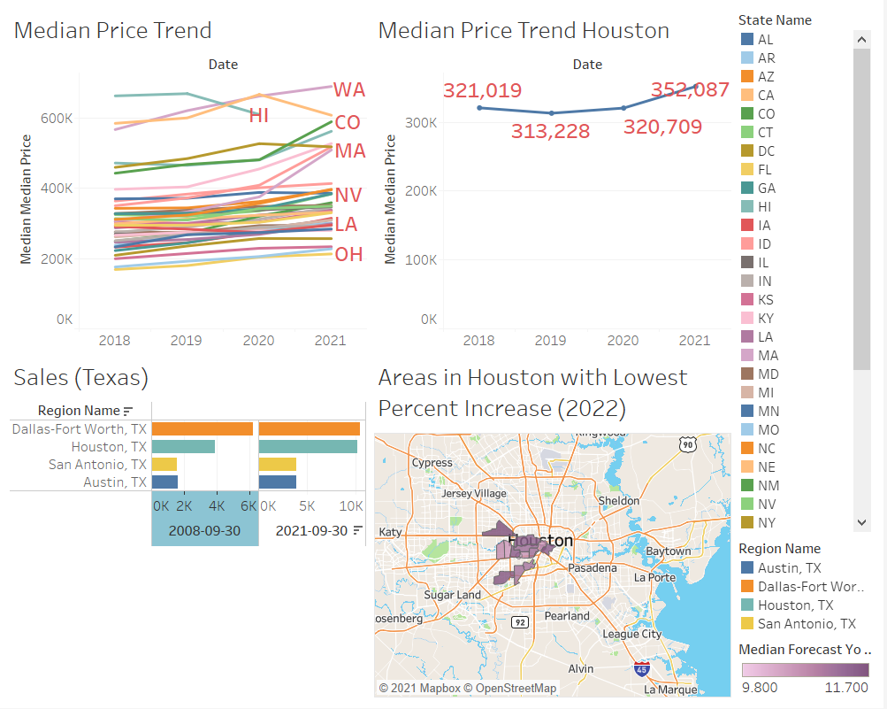

Slide 4
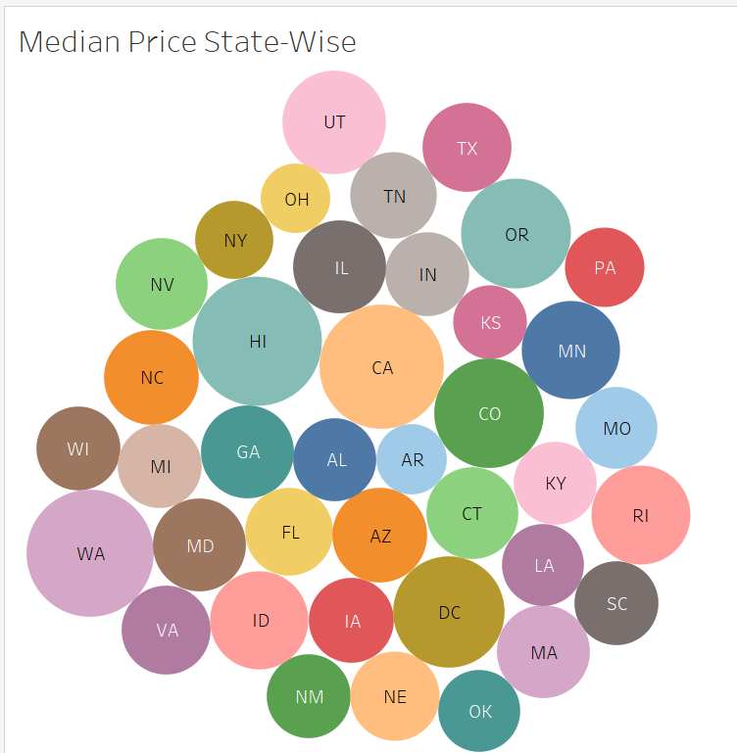
Median price (State-wise)
California, Hawaii, Washington and Oregon leads all states in median prices
The median prices of the other states appears to be in a limited range.
It appears living in West coast is costlier vs rest of the country.
Notes:
We are looking at state wise median prices, and CA, HI, WA, OR leads all states in median prices.
The median prices for all the other states appears to be in the same range.
Living in West coast is costlier vis-à-vis rest of the country.

Slide 5
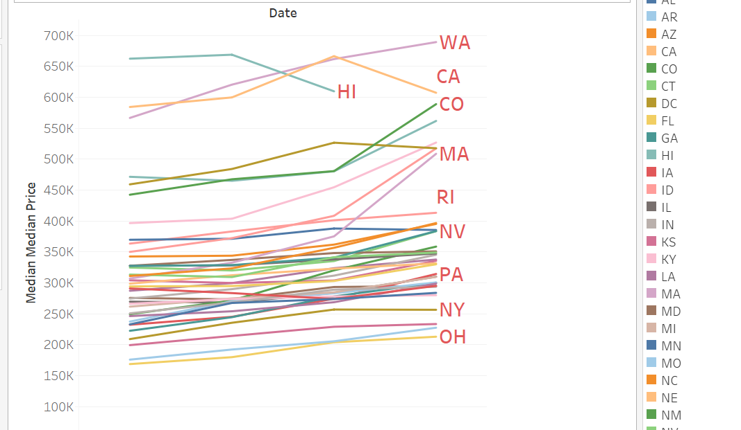
Median price trend (State-wise)
Statewise Median prices appears to have an upward trend in most state.
CA, HI being the costliest to live also appears to have a downward trend in median prices.
Notes:
We are now looking at Statewise median price trend
And there is an upward trend for most of the states except for CA, HI, where the median prices are going down.

Slide 6
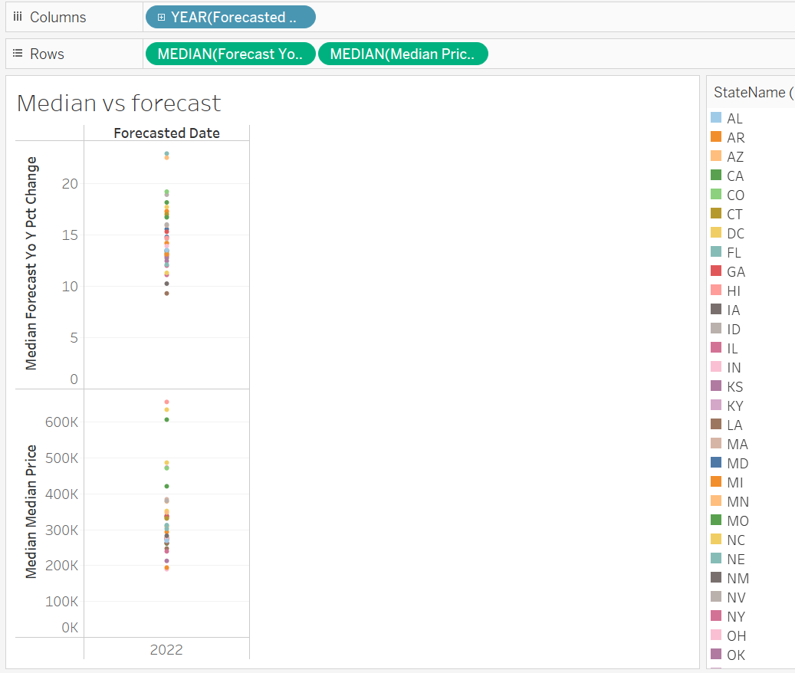
Median vs forecast (State-wise)
Median prices will continue to increase in prices by 10-20% on Y-to-Y basis.
Current Median prices from 200K to 500K may see increase of at least 220K to 550K in lower estimate.
Notes:
Median prices are expected to go up on Y-Y basis by 10 to 20%, so a home which is 200K to 500K may go up by atleast 220 to 550K in lower estimate.

Slide 7
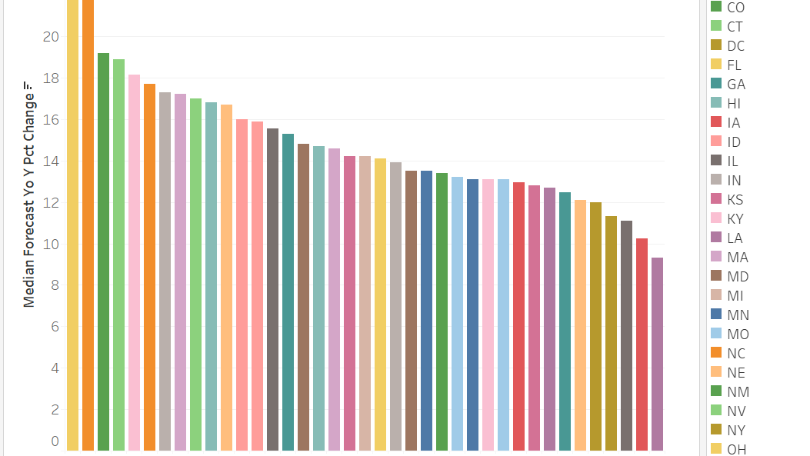
Prices forecast (State-wise)
Arizona leads as the potential for maximum increase in median prices.
Substantiate that the price increase maybe within 10 to 20%
Notes:
We are looking at statewise comparison of price increase, and Arizona appears to be more than 20%
On average, the prices may increase from 10 to 20%, which substantiate our earlier forecast prediction

Slide 8
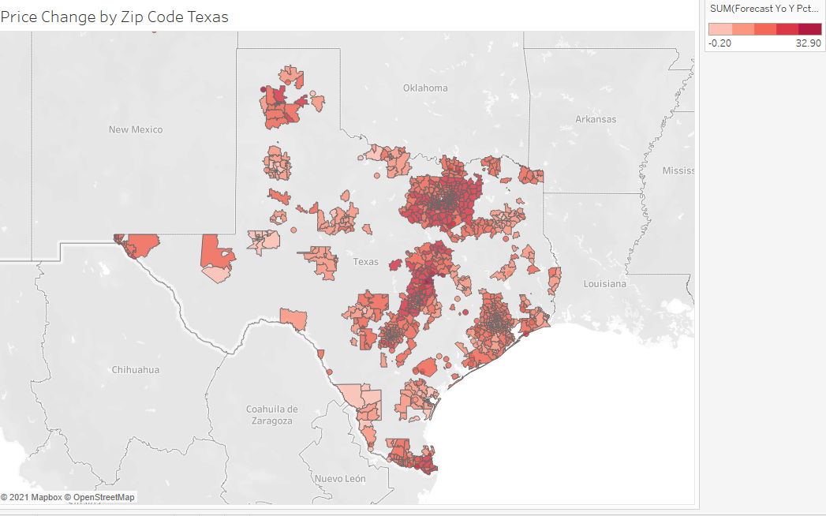
Hot spot (Texas)
There are some hot spots in Texas. We can see major cities like Austin, Dallas, Houston, San Antonio population are increasing. So, we can assume that House seals will be rising on those spots.

Slide 9
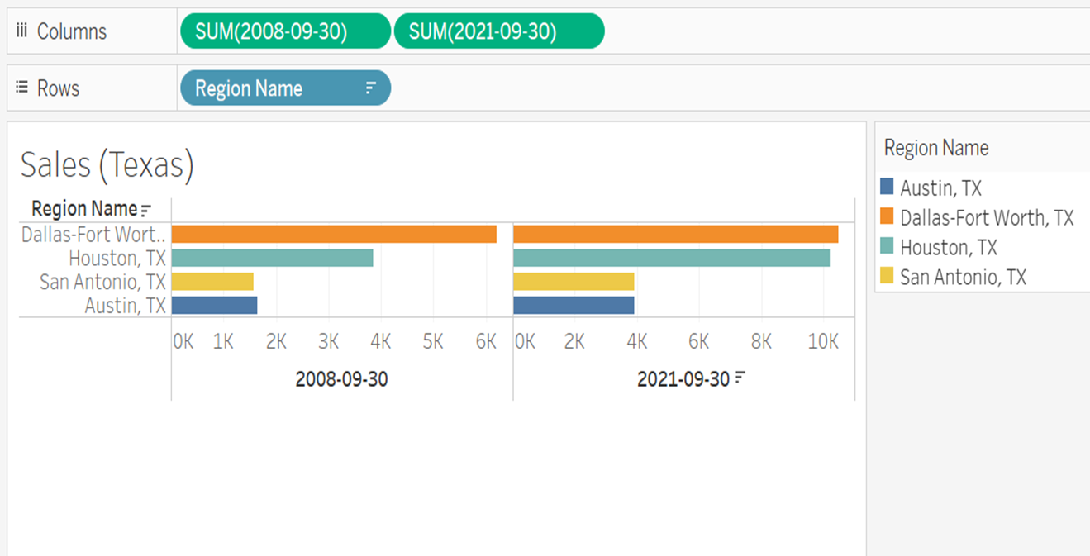
Sales (TexaS)
In 2008 Dallas-fort worth had the highest home seals its more than 6k, and now, in 2021, it increased to almost 10k.
Houston increased home seals from 2008 to 2021. It's almost as same as Dallas-fort worth.
Home sales prices increased more in Houston than in any other city in Texas.

Slide 10
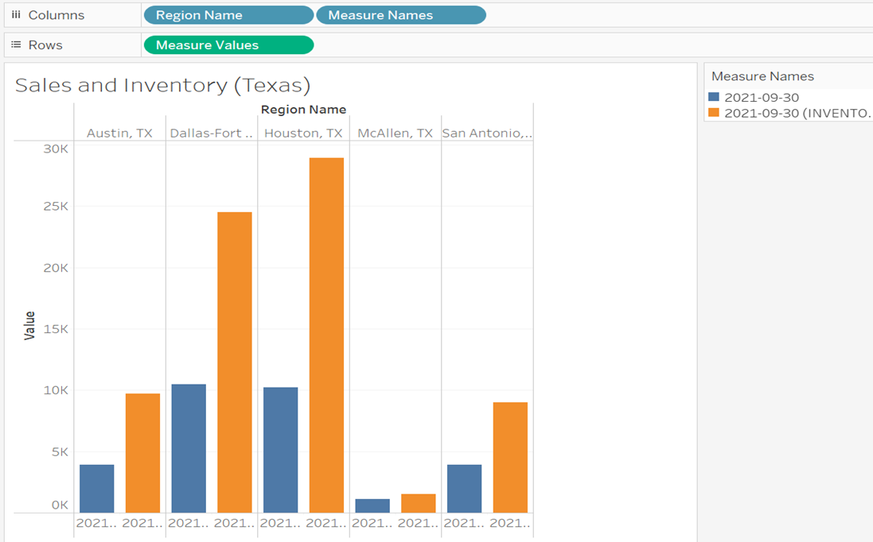
Sales and inventory (Texas)
The Highest inventory was in Houston and Dallas-Fort Wort. But the Sales rate is higher in Houston than in Dallas-Fort Worth in September 2021.
The Lowest Inventor and house sales were in McAllen in September 2021.
Notes:
.

Slide 11
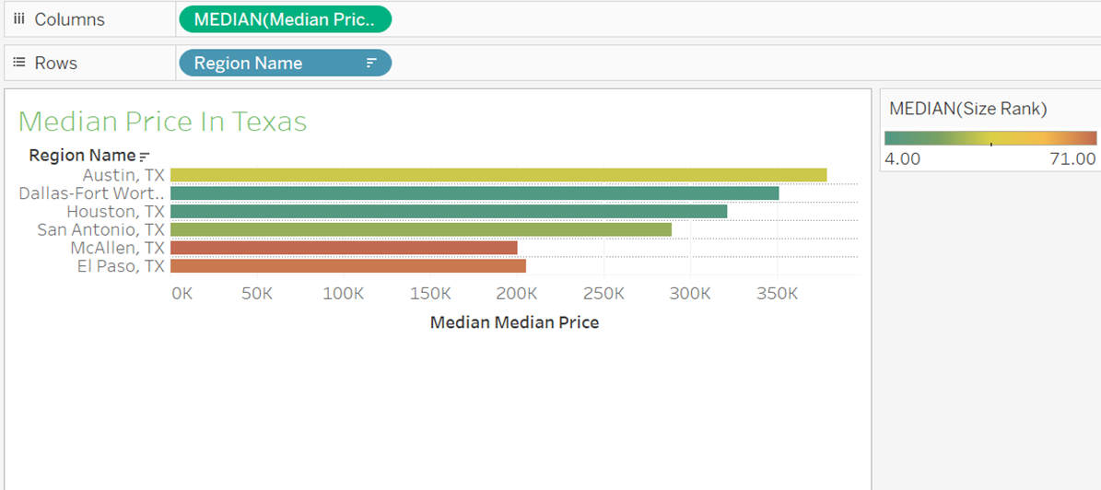
Median prices (Texas)
Median of Median price was higher in Austin; it's almost 370k. But according to Median size Rank Austin had 35.00
The highest Median price rank had McAllen; it was 72.00
The Median of Median price for Houston was 321k, and the Median size rank was 6.00

Slide 12
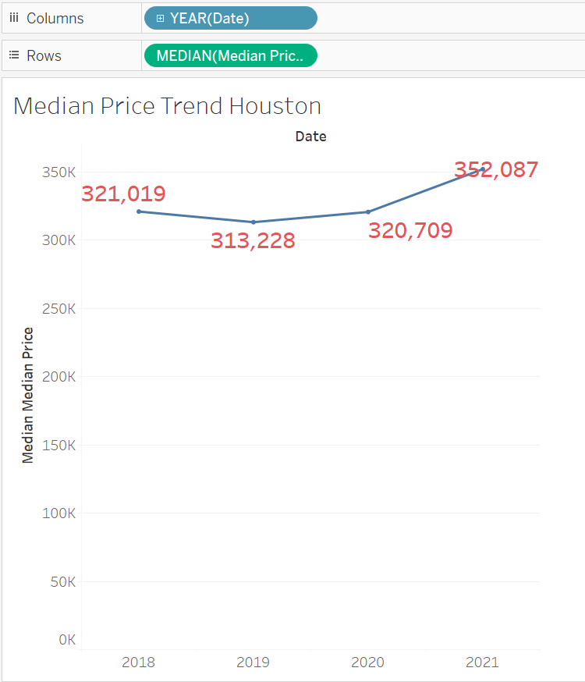
Median prices (houston)
Median house price in Houston decreased from 2018 to 2019
Median house price increased slightly from 2019 to 2020, with a sharper increase from 2020 to 2021

Slide 13
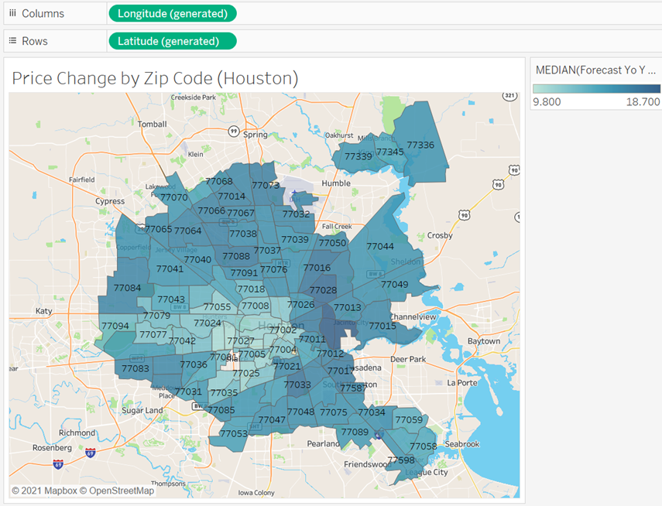
Price change by zip code (houston)
Zip codes in central and downtown Houston show the lowest forecasted percent increase in housing prices
Surrounding areas have a relatively higher forecasted percent increase

Slide 14
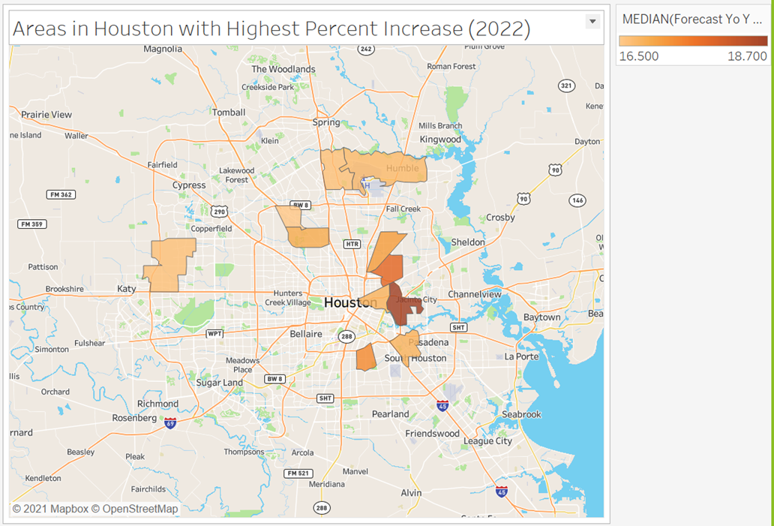
Areas in houston highest price increase(2022)
The areas in Houston with the highest forecasted percent increase are east Houston and parts of north and west Houston

Slide 15
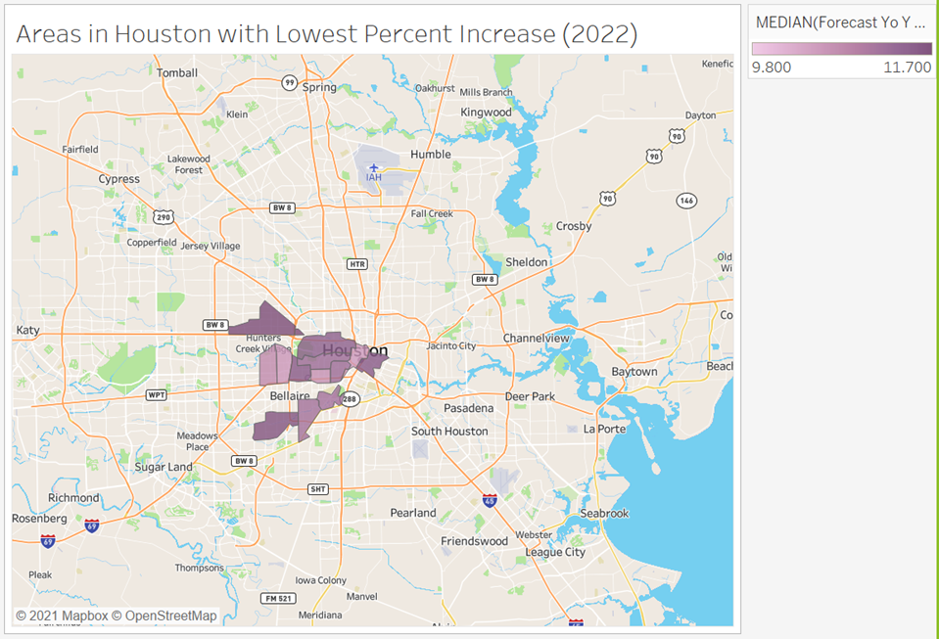
Areas in houston with lowest price increase (2022)
The areas in Houston with the lowest forecasted percent increase are central and downtown Houston

Slide 16
conclusion
Most states within the US continues to see a trend of upward median prices, showing a strong demand for homes.
Texas shows a strong city wise demand for homes in Austin, San Antonio, Dallas, Houston Quadrangle.
Houston shows a trend of increase in Housing prices away from the downtown area.
The price of homes is expected to continue to increase in near future.

Slide 17
Video Link :
Video Link :
https://uhdowntown-my.sharepoint.com/personal/hoguem1_gator_uhd_edu/_layouts/15/onedrive.aspx?ct=1638384124730&or=OWA%2DNT&cid=6e3b24c1%2Dd09a%2Dfb39%2Dc762%2D76505d7fbd35&id=%2Fpersonal%2Fhoguem1%5Fgator%5Fuhd%5Fedu%2FDocuments%2FPresentation%2Fvideo1552232246%2Emp4&parent=%2Fpersonal%2Fhoguem1%5Fgator%5Fuhd%5Fedu%2FDocuments%2FPresentation

